Slide 1
G9 Unit 8
Writing Task 1
Describing Bar charts
Task requirements:
3 paragraphs
150 words

Slide 2
Bar charts usually show a comparison of 2 or more items.

Slide 3
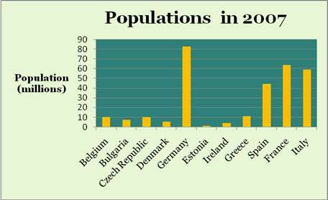
1. Observe the following chart :
It shows the populations of various European countries in the year 2007.
The populations are only for one year, 2007, so we can only compare one county with another.

Slide 4
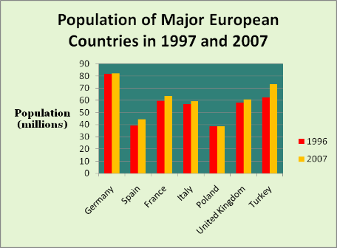
2. Observe the following chart :
Bar charts are often used to make multiple comparisons
It shows the populations of major European countries in the years 1996 and 2007.
In this case we can make two sets of comparisons.
We can look at the change in population from 1996 to 2007 for each country, and we can compare the populations of the various countries in each year.

Slide 5
Writing Tips
1. First, look at the Chart Title.
This tells you what information the chart displays and you can use this information in your description.
2. Then look at the X and Y axes.
The titles of these axes sometimes give you information you can use in your description. It is important also to look at the UNITS.

Slide 6
Writing Tips
3. Bar charts show similarities and differences. When describing these charts you need to make comparisons.
4. Group together any columns which have broad similarities.

Slide 7
Task approach
To write a short description of the graph ask yourself (and answer!) the following questions:
1. What exactly does the chart show? (Use the chart title to help you answer this question)
2. What are the axes and what are the units?
3. What similarities are there?
4. Is it possible to put some of the columns into one or more groups?
5. What differences are there?
Answering these questions will help you to write a short description of this simple Bar chart.

Slide 8
Essay Outline
Introduction + Overview: 3 sentences
Say exactly what the chart shows, and the time period.
The bar chart shows / gives information about……
Then look at the X and Y axes. Use the information in the titles of these axes in your description. Also include the UNITS.
The x axis of the graph represents the …………….. while the y axis shows the ………….. in numbers / units / dollars.
Write an overview (describe the most important change)
As can be clearly seen, …………….. / Overall, …..

Slide 9
2. Body
Describe the items / changes as precisely as possible.
Looking at the chart in more detail, we can see that ………..
Use data and numbers from the bar chart.
Compare the information. Write about the differences and similarities between the groups shown using comparative and superlative.
To signal comparison and contrast within a sentence you can use the following conjunctions:
as ....... as, not as ......... as, not so ........ as, whereas, but, while, although
To signal comparison and contrast between sentences you can use the following words and phrases:
However, By contrast, On the other hand, In comparison

Slide 10
3. Conclusion:
Conclude by saying what the main trends or changes are ( e.g. making a comparison)
Overall / In general, we can see a clear upward / downward trend in the …………….. while the …………………..seem to have ………………………..
Do not use numbers!

Slide 11
PRACTICE

Slide 12
You should spend about 20 minutes on this task.
The chart below shows the amount of leisure time enjoyed by men and women of different employment status.
Summarise the information by selecting and reporting the main features, and make comparisons where relevant.
Write at least 150 words.

